Slide 1
Using this slide deck
Your project presentation should include at least one of each of the following slide types:
  Title
  Overview
  Basin Location
  Context and Development
  Concept Map
  Site photos (optional, but encouraged)
  Partnerships
  Outcomes
  Timeline
  Budget
For some of the slide types, such as concept maps, there are multiple examples included in this deck to give an idea of different ways you might create these maps for different project types. You do not have to create multiple concept map slides for one project (but can, if needed)
For some slide types, this template includes additional resources and comments which will help create stronger presentation materials in the notes section
Submit RIT presentation slides to your RIT lead no later than the Friday prior to the upcoming RIT meeting
  Include Drew Mealor and Julie Grobelny (Andrew.Mealor@dfw.wa.gov; Julie.Grobelny@dfw.wa.gov) on this email
Before submitting your slides, you can delete this first slide, and any extra “example” slides

Slide 2
Project Title
Project Name (Stream name_Location_Type_Phase)
Presented by: (names and Org)

Slide 3
Project Title : Overview
  Sponsor/Budget: (Sponsor org/ total ASRP grant request; can also include total project cost)
  Landowner type: (e.g. forestry, agricultural, state owned, residential- do NOT include landowner names)
  EcoRegion and GSU: (e.g. Cascade Mountains/ Mainstem Newaukum)
  ASRP Grant Category: (Priority Project vs Opportunistic Project)
  ASRP Project Scope: (e.g. local strategy, Barrier Correction, Reach Scale, Riparian etc)
  ASRP Project Tasks: (e.g. Planning, Acquisition, Design, Construction)
  Short Description: this can be a one sentence summary of the project scope
  ASRP Priority Actions for this location:
  Limiting Factors this project addresses:
  ASRP Species(Project Focal Species; list other species present at site):
Notes:
ASRP Grant Category and Type:
The ASRP Funding Guidelines defines the different Grant Categories (Priority or Opportunistic) and Types
XXXXXXXXXXXXXXXXXXXXXXXXXXXX Add link to funding guidelines
ASRP Priority Actions for this location:
This is in reference to the ‘Restoration Actions’ listed in the ASRP Priority Areas and Actions Tables for the priority area GSU
https://chehalisbasinstrategy.com/implementing-projects/
Please list the ‘highest priority’ restoration actions this project will address
Limiting Factors this project addresses:
This is in reference to the ‘Limiting Factors’ listed in the ASRP Priority Areas and Actions Tables for the priority area GSU
https://chehalisbasinstrategy.com/implementing-projects/
Please list the highest priorities this project will address
ASRP Focal Species(Focal; present or otherwise relevant at site):
List at the end of this slide deck

Slide 4
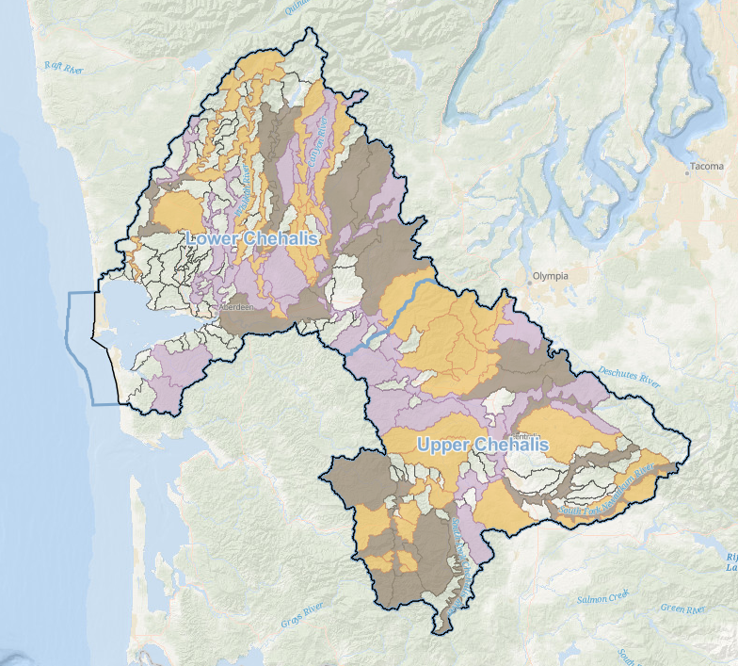
Project Title : Basin Location
Include:
Inset Map showing entire basin:
  Place star on project location on the zoomed out map
Larger map showing location within sub-basin:
  Use USGS topo map (or similar), available on ASRP webmap
  North arrow
  Lat/long
  Draw in the creek or pertinent roads – size 14 font
  Label major roads, highways, and towns to help identify where the project is located- size 14 font or larger
  For multiple projects: Include on one map
  Nearby restoration projects
    Include phase/ construction date
  Fish passage correction projects
    Include WDFW site Id (link in notes), correction date
  Feel free to include more than one map!
    If applicable, can also indicate the different landowners/land use
    If many other constructed/funded projects in area, could go on separate map
lat, -long
N
XX mi
Notes:
Zoomed in location
You could use…
the ECY ASRP web map
https://gis.ecology.wa.gov/portal/apps/experiencebuilder/experience/?id=88b5b1cfe9d0482c936f6664e931ed7e&page=Page&views=Layers
Google topo maps, etc
Fish passage correction projects, please include the WDFW site ID#
WDFW Fish Passage Map
https://geodataservices.wdfw.wa.gov/hp/fishpassage/index.html
Chehalis Fish Passage Barrier Prioritization Map
https://geodataservices.wdfw.wa.gov/hp/chehalisprioritization/index.html
Can include additional slide/s with maps to show the location of the project

Slide 5
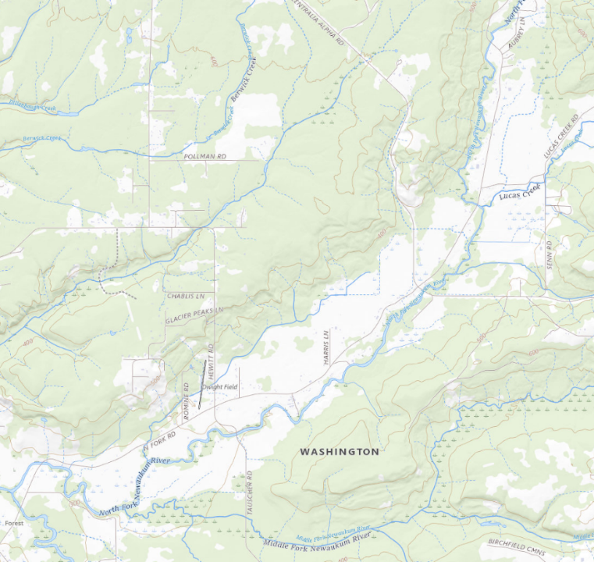
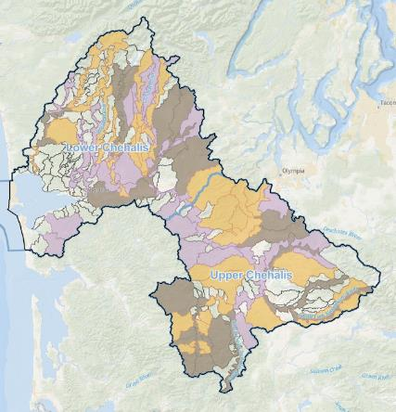
(example 1) Project name: Basin Location
Site 4
N Fork Rd
EXAMPLE
Lucas Crk
Site 3
Centralia Alpha RD
N Fork Newaukum
N Fork Rd
Site 2
-122.828, 46.609
Tauscher RD
N
Site 1
M Fork Newaukum
1 mile
Notes:
Include:
inset map showing project location in the basin
This map should include GSUs color coded by priority
Easiest to just use the map included in this slide, and move the red circle to your project location
Larger map showing project context within sub-basin
The goal of this map is to show where the project is located within the GSU/relevant sub-basin. Depending on the scale of the project, this does not need to include project concept actions.
This map should show the entire project area, the nearest/largest road(s), and the nearest/largest stream. Ideally, also show the confluence with the next largest stream (the example showed the confluence with the N Fork Newaukum and the MS Newaukum)
Include the locations of any relevant projects or fish passage barriers
This should always be a USGS topo map, NOT lidar or google earth imagery
Google earth imagery is often too dark for annotations or roads to appear correctly
North arrow
Lat/long (just center of project)
Fish passage projects- also include WDFW site ID(s)
Draw in the creek or pertinent roads if they are difficult to see
Label major roads, highways, and towns to help identify where the project is located
Map default labels are often too small to easily read when presenting over zoom- create new text boxes with size 14 font for the most important streams and roads
Feel free to include more than one map! You might need multiple maps at different scales depending on the project. Do not clutter any single map with too much information.
Resources:
Chehalis Basin Strategy – ASRP webmap
“Chehalis Basin Boundaries” layer dropdown will let you toggle ASRP GSUs on and off
The “Basemaps and Lidar” layer dropdown will let you toggle USGS topo maps
Can toggle SRP project locations
Also includes fish passage information, stream layers, and rivermiles

Slide 6
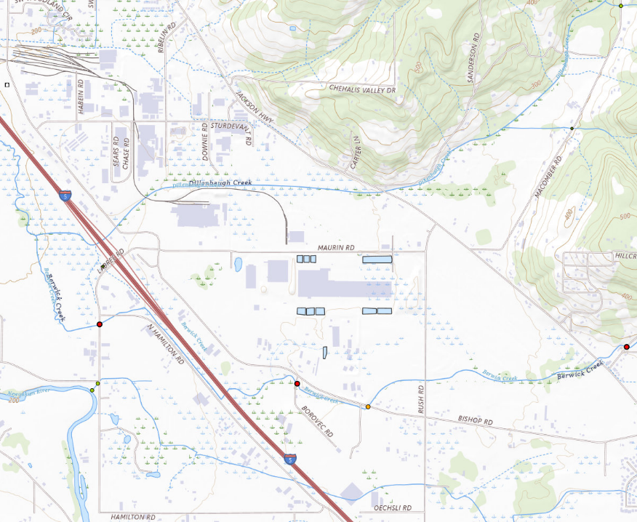
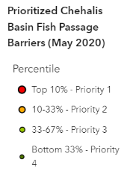
(example 2) Project name: Basin Location
EXAMPLE
Dillenbaugh Creek
SRFB funded
Constructed 2024
Jackson Hwy
Berwick Creek
Bishop RD
This Project: WDFW site ID# 601456
67% passable; barrier due to velocity
SRFB funded construction 2025
Berwick Creek
Bishop RD
Applied for culvert AOP, WCRRI funding and will request ASRP funding
-122.912, 46.618
Tauscher RD
Newaukum
N
1 mile
Notes:
Include:
inset map showing project location in the basin
This map should include GSUs color coded by priority
In this example, the intent of this inset map is to show the proximity to the near term GSU, so it is more “zoomed in” compared to example 1. It still is zoomed out enough to show major towns such as Chehalis and centralia. This example map clearly shows that this project is outside of near term areas, and located in the I5 corridor south of Chehalis.
Larger map showing project context within sub-basin
The goal of this map is to show where the project is located within the GSU/relevant sub-basin. Depending on the scale of the project, this does not need to include project concept actions.
This map should show the entire project area, the nearest/largest road(s), and the nearest/largest stream. Ideally, also show the confluence with the next largest stream (the example showed the confluence with Berwick and Dillenbaugh)
Include the locations of any relevant projects or fish passage barriers
This example shows both year and funding source for upstream and downstream projects
This should always be a USGS topo map, NOT lidar or google earth imagery
Google earth imagery is often too dark for annotations or roads to appear correctly
North arrow
Lat/long (just center of project)
Fish passage projects- also include WDFW site ID(s)
Draw in the creek or pertinent roads if they are difficult to see
Label major roads, highways, and towns to help identify where the project is located
Map default labels are often too small to easily read when presenting over zoom- create new text boxes with size 14 font for the most important streams and roads
Feel free to include more than one map! You might need multiple maps at different scales depending on the project. Do not clutter any single map with too much information.
Resources:
Chehalis Basin Strategy – ASRP webmap
“Chehalis Basin Boundaries” layer dropdown will let you toggle ASRP GSUs on and off
The “Basemaps and Lidar” layer dropdown will let you toggle USGS topo maps
Can toggle SRP project locations
Also includes fish passage information, stream layers, and rivermiles
Fish passage correction projects, please include the WDFW site ID#
WDFW Fish Passage Map
https://geodataservices.wdfw.wa.gov/hp/fishpassage/index.html

Slide 7
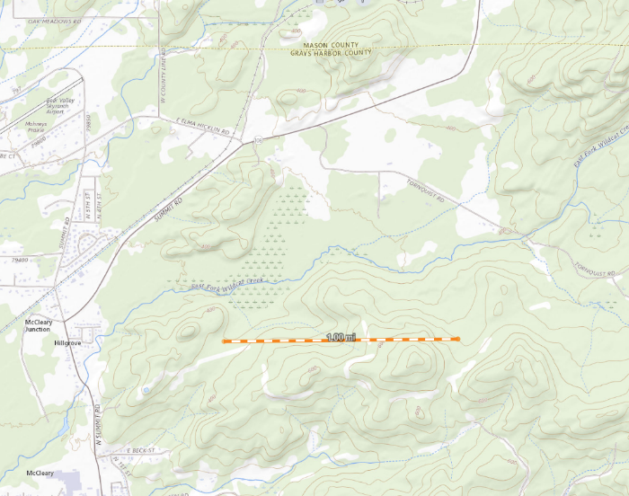
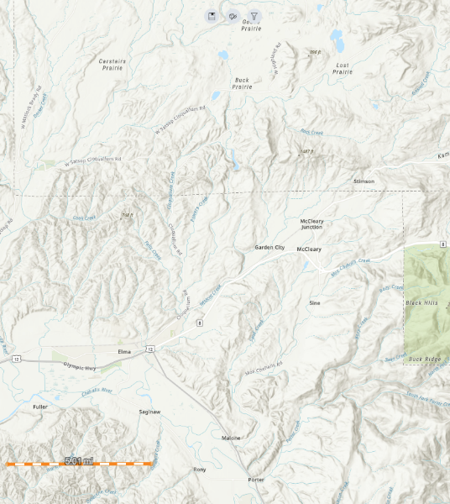
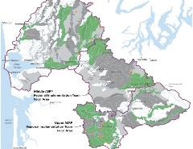

Project name: Basin Location (example 3)
EXAMPLE
Tornquist RD
Summit RD
East Fork Wildcat Creek
Project Reach
McCleary
N
1.O mi
Elma
N Summit RD
McCleary
5.O mi
47.069892560676685, -123.25526955991299
Notes:
Include:
inset map showing project location in the basin
This map should include GSUs color coded by priority
In this example, the project is not located near major landmarks recognizable to the average viewer, so an additional map is used to show the location of the project relative to Elma and hwy 8.
Larger map showing project context within sub-basin
The goal of this map is to show where the project is located within the GSU/relevant sub-basin. Depending on the scale of the project, this does not need to include project concept actions.
This map should show the entire project area, the nearest/largest road(s), and the nearest/largest stream. Ideally, also show the confluence with the next largest stream
Include the locations of any relevant projects or fish passage barriers
This example shows both year and funding source for upstream and downstream projects
This should always be a USGS topo map, NOT lidar or google earth imagery
Google earth imagery is often too dark for annotations or roads to appear correctly
North arrow
Lat/long (just center of project)
Fish passage projects- also include WDFW site ID(s)
Draw in the creek or pertinent roads if they are difficult to see
Label major roads, highways, and towns to help identify where the project is located
Map default labels are often too small to easily read when presenting over zoom- create new text boxes with size 14 font for the most important streams and roads
Feel free to include more than one map! You might need multiple maps at different scales depending on the project. Do not clutter any single map with too much information.
Resources:
Chehalis Basin Strategy – ASRP webmap
“Chehalis Basin Boundaries” layer dropdown will let you toggle ASRP GSUs on and off
The “Basemaps and Lidar” layer dropdown will let you toggle USGS topo maps
Can toggle SRP project locations
Also includes fish passage information, stream layers, and rivermiles

Slide 8
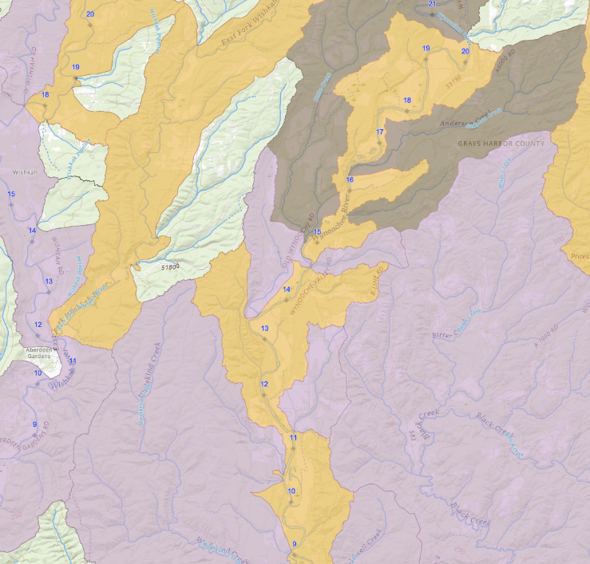
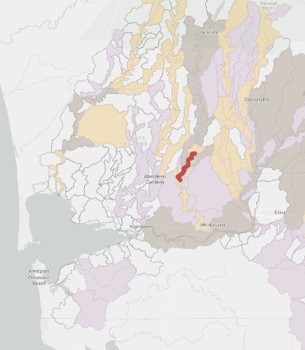
Project name: Basin Location (example 4)
Anderson Creek
Helm Creek
Project Development Reach
Wynoochee River
N
EXAMPLE
Near Term
Mid Term
Long Term
Notes:
Include:
inset map showing project location in the basin
This map should include GSUs color coded by priority
Larger map showing project context within sub-basin
The goal of this map is to show where the project is located within the GSU/relevant sub-basin. Depending on the scale of the project, this does not need to include project concept actions.
This example shows a project development over a large area
This map should show the entire project area, the nearest/largest road(s), and the nearest/largest stream. Ideally, also show the confluence with the next largest stream
Include the locations of any relevant projects or fish passage barriers
This should always be a USGS topo map, NOT lidar or google earth imagery
Google earth imagery is often too dark for annotations or roads to appear correctly
Scale bar- this example is missing a scale bar. Due to the large size of the project development area, rivermile markers also would be helpful
North arrow
Lat/long (just center of project)
Fish passage projects- also include WDFW site ID(s)
Draw in the creek or pertinent roads if they are difficult to see
Label major roads, highways, and towns to help identify where the project is located
Map default labels are often too small to easily read when presenting over zoom- create new text boxes with size 14 font for the most important streams and roads
Feel free to include more than one map! You might need multiple maps at different scales depending on the project. Do not clutter any single map with too much information.
Resources:
Chehalis Basin Strategy – ASRP webmap
“Chehalis Basin Boundaries” layer dropdown will let you toggle ASRP GSUs on and off
The “Basemaps and Lidar” layer dropdown will let you toggle USGS topo maps
Can toggle SRP project locations
Also includes fish passage information, stream layers, and rivermiles

Slide 9
Project name: Context and Development
Map and/or figure showing boundary/findings of any previous prioritization/ project development effort,
Can also show other relevant funded/constructed projects
Name any previous project development effort, including
  Timeline
  Findings/prioritizations
  Funding amount
  Participating organization
Name any relevant study (esp. ASRP studies), including
  Findings
  timeline
Notes:
Link to a list of ASRP-funded studies: https://officeofchehalisbasin.com/publications/ Scroll down to "Office of Chehalis Basin program studies and reports" and open the "Aquatic Species Restoration Program (ASRP)" accordion.
For questions or more information about studies, data collection efforts, or recent findings, reach out to: Victoria.Knorr@dfw.wa.gov.

Slide 10
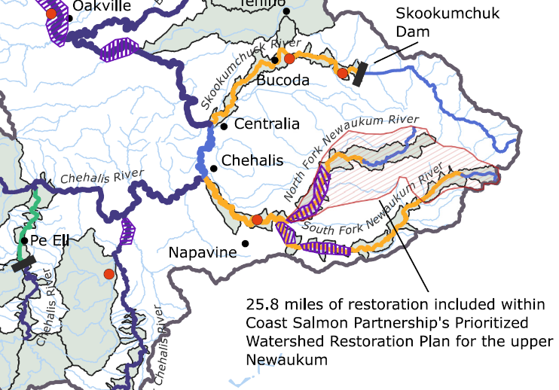
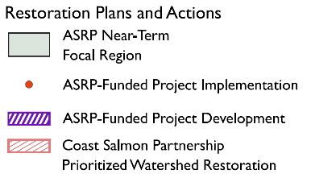
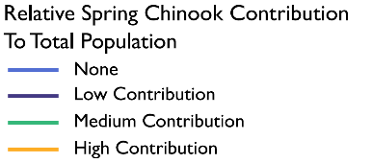
Project Name: Context and Development (example 1)
EXAMPLE
Notes:
This example could be improved by included the years of the previous project developments. Additional slides could give more details on the outcomes of the Newaukum Prioritized Watershed Restoration effort. Additional slides could also show findings from ASRP studies.

Slide 11
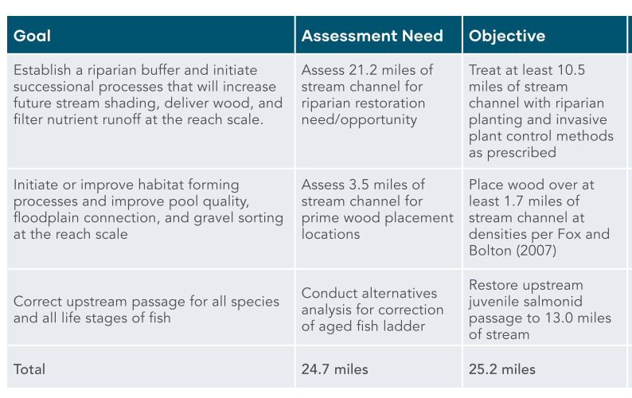
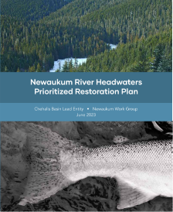
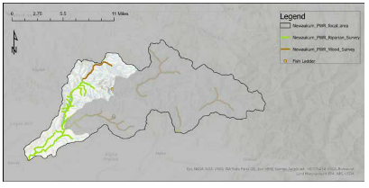
Project Name: Context and Development (example 1.1)

Slide 12
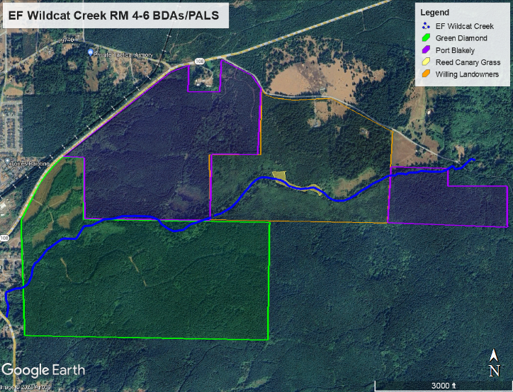
Project Name: Context and development (example 2)
Initial contact from orange parcel
Expanded project to 2 mile reach to incorporate bordering timberland owners
Initial landowner, Green Diamond, and Port Blakely interested in BDAs and PALS.
No forest roads or other infrastructure within project area
Summit RD
Tornquist RD
EXAMPLE
Participating Landowner
Port Blakely
Port Blakely
Green Diamond

Slide 13
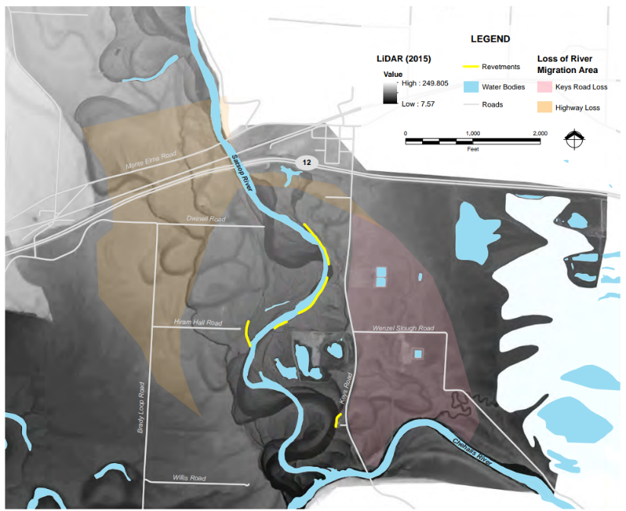

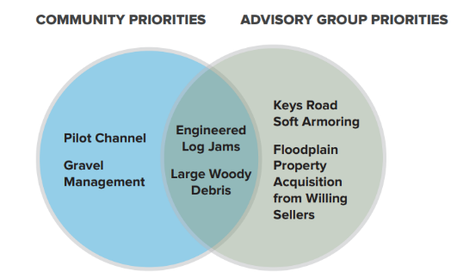
Project Name: Context and Development (Example 3)
EXAMPLE

Slide 14
Project name: Concept map (construction/design)
Zoomed in to site location
Scale bar
North arrow
Legend
Polygons/lines showing general project actions- not highly detailed engineered drawings
Minimum font size should be around 18 pt. Engineered drawings will likely have text that is too small to read when presented. If using these drawings, you should annotate the image to add larger text and thicker lines around the action areas (or request similar from engineer)
Okay to use google imagery here- but lighted the image so that the annotations will be more legible. This can be done directly in google earth, or in powerpoint (making the image slightly transparent, or alternatively overlaying a slightly transparent white rectangle
Each project action should have an associated metric- eg acreage of riparian planting
  Dependent on project phase; might not be known for early phase projects
For very large projects or projects with multiple sites, use multiple slides. You might need an inset map to show the concept area’s location within the greater project area
Resources:
  Google earth
  Engineers (might need to ask for concept map with specific font size)
Notes:
If you do have engineered designs- please include as part of application materials
**Encourage you to reach out to the Area Habitat Bio (Daron Williams, Brandon Carman, Noll Steinweg) and the ASRP Coordinator (Julie Grobelny) early on during project development for a site visit to discuss ways to maximize the benefits of the project for the natural resources, as well as to address any HPA concerns and get ahead of potential questions the TRT or SC could have about the project.

Slide 15
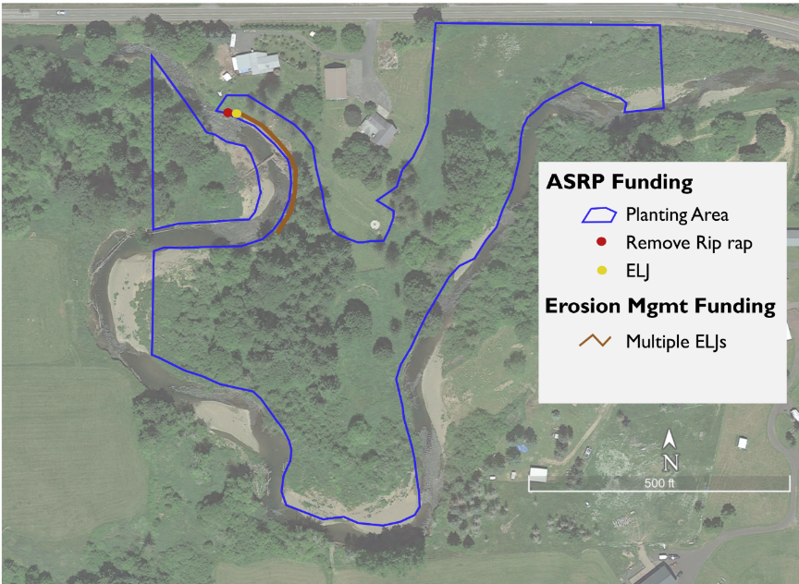
Project Name Concept Map (example 1)
List main actions here, e.g. 8 acres of riparian planting, two ELJs
ELJ
EXAMPLE
Notes:
This map should include:
Scale bar
North arrow
Legend
Polygons/lines showing general project actions
Minimum font size should be around 18 pt. Engineered drawings will likely have text that is too small to read when presented. If using these drawings, you should annotate the image to add larger text and thicker lines around the action areas
Okay to use google imagery here- but lighted the image so that the annotations will be more legible. This can be done directly in google earth, or in powerpoint (making the image slightly transparent, or alternatively overlaying a slightly transparent white rectangle
Each project action should have an associated metric- eg acreage of riparian planting
For very large projects or projects with multiple sites, use multiple slides. You might need an inset map to show the concept area’s location within the greater project area
Resources:
Google earth
Engineers (might need to ask for concept map with specific font size)

Slide 16
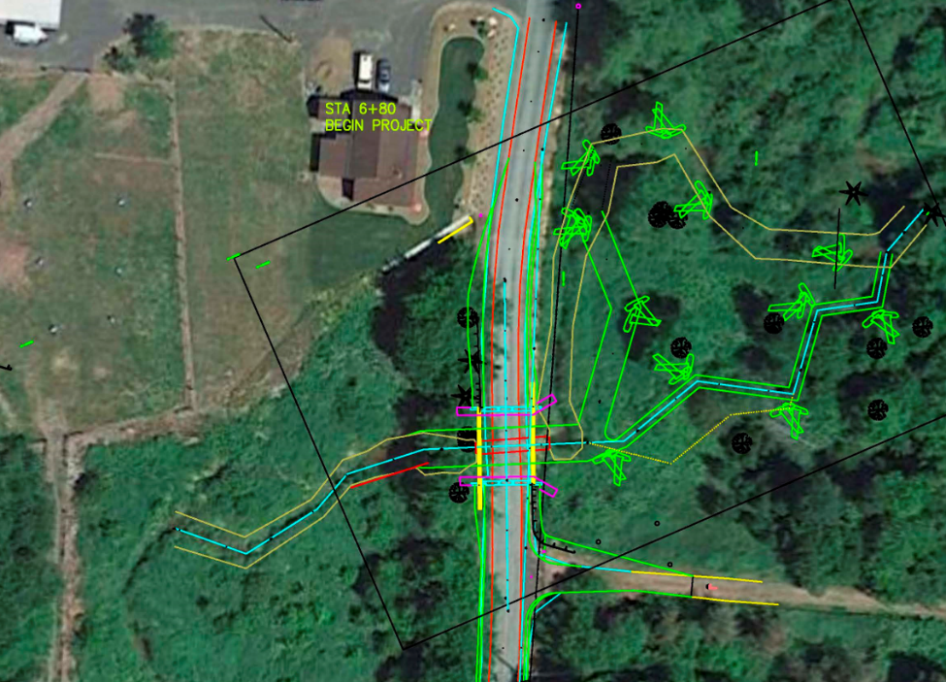
Project Name Concept Map (example 2)
List main actions here, e.g., size of bridge, number of log structures, status of current crossing (culvert size, passing percentage)
New off-channel/high flow
New 27.5’ wide x 39’ long bridge
Proposed Channel
EXAMPLE
Notes:
This map should include:
Scale bar
North arrow
Legend
Polygons/lines showing general project actions
Minimum font size should be around 18 pt. Engineered drawings will likely have text that is too small to read when presented. If using these drawings, you should annotate the image to add larger text and thicker lines around the action areas
Okay to use google imagery here- but lighted the image so that the annotations will be more legible. This can be done directly in google earth, or in powerpoint (making the image slightly transparent, or alternatively overlaying a slightly transparent white rectangle
Each project action should have an associated metric- eg acreage of riparian planting
For very large projects or projects with multiple sites, use multiple slides. You might need an inset map to show the concept area’s location within the greater project area
Resources:
Google earth
Engineers (might need to ask for concept map with specific font size)

Slide 17
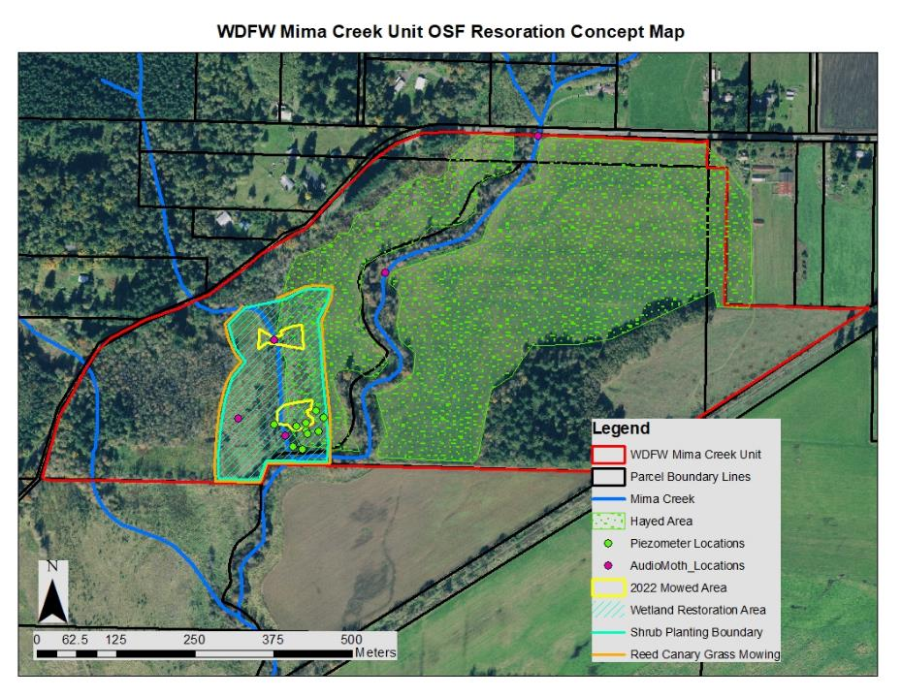
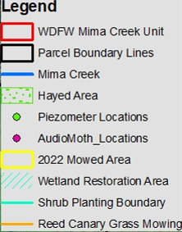
Project Name Concept Map (example 3)
EXAMPLE
Notes:
This example could have been improved by annotating the acreage of the restoration activities
This map should include:
Scale bar
North arrow
Legend
Polygons/lines showing general project actions
Minimum font size should be around 18 pt. Engineered drawings will likely have text that is too small to read when presented. If using these drawings, you should annotate the image to add larger text and thicker lines around the action areas
Okay to use google imagery here- but lighted the image so that the annotations will be more legible. This can be done directly in google earth, or in powerpoint (making the image slightly transparent, or alternatively overlaying a slightly transparent white rectangle
Each project action should have an associated metric- eg acreage of riparian planting
For very large projects or projects with multiple sites, use multiple slides. You might need an inset map to show the concept area’s location within the greater project area
Resources:
Google earth
Engineers (might need to ask for concept map with specific font size)

Slide 18
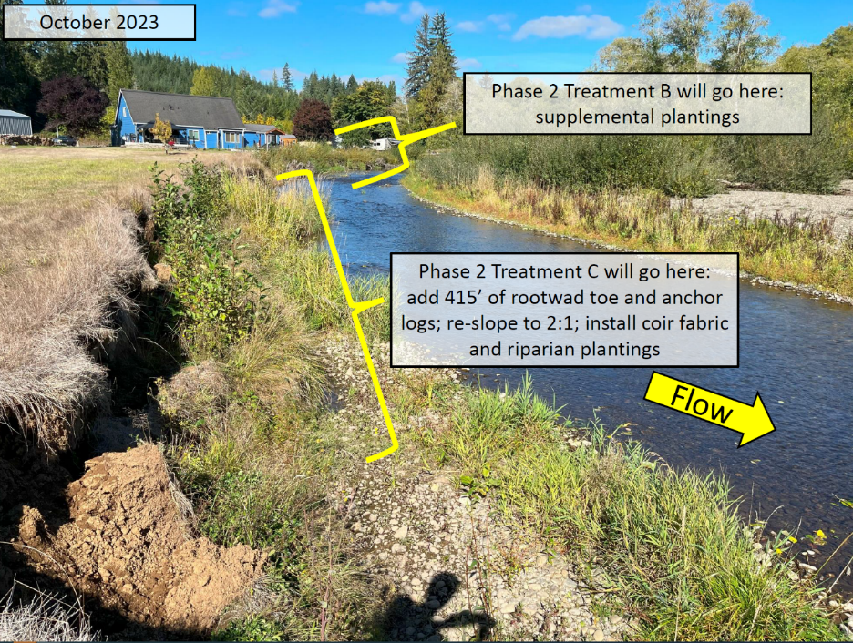
Project Name: Site photos (encouraged!) example 1
EXAMPLE
Notes:
This is a good example:
Large, legible annotations
Flow arrow
Date
Reference to component names (treatment c) included on concept map
Could be improved by:
small inset map showing location within project area

Slide 19
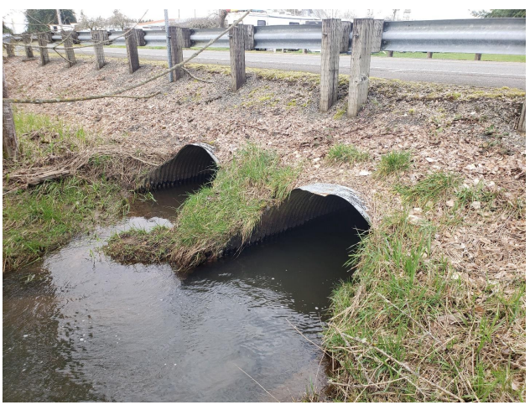
Project Name: Site photos (encouraged!) example 2
EXAMPLE
View of the outlet of the existing structure
Notes:
This is a good example:
Shows existing conditions clearly (not obscured by vegetation)
Labeled
Road guard in photo helps give sense of scale
Could be improved by:
Annotation showing size of culvert
Note on passing percentage, reason for listing as barrier
WDFW site ID

Slide 20
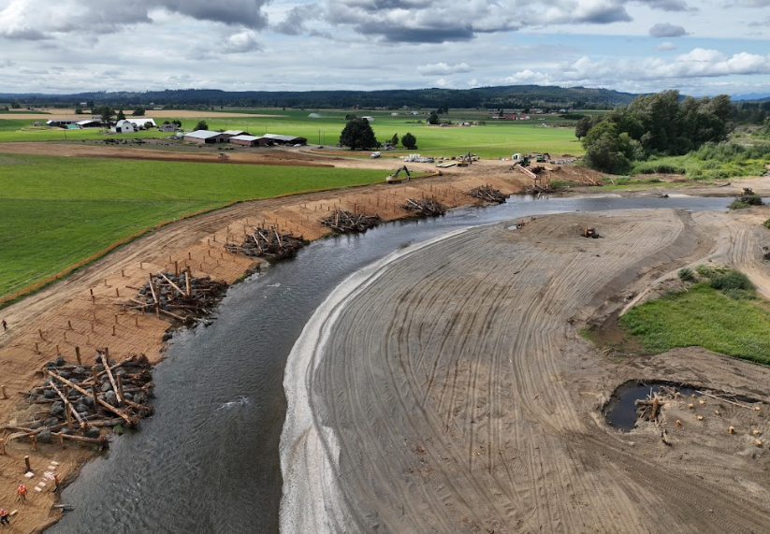
Project Name: Site photos (encouraged!) example 3
EXAMPLE
Notes:
This is a good example:
Great drone shot showing conditions right after construction
Water is low, entire structure is visible
People in photo helps give sense of scale
Could be improved by:
Annotation for size of structure
Date
Flow arrow
Annotation delineating any future work areas, eg planting

Slide 21
Project Title: Project Partnerships
List any project partnerships and their relationship to this project, including:
Co-sponsors
Supplemental funding/ shared resources
organizations participating in project development workshops/ planning efforts
Other coordination

Slide 22
Project Title : Outcomes
What is the overall goal of this project? Distinguish between long term outcomes (“increased shade from planted trees”) and more immediate outcomes (“
How are the proposed projects actions in line with ASRP priorities? Refer to ASRP priority areas and actions tables
Include the following metrics with specified phase (planning, design, construction):
  Landowners/interested parties contacted
  Miles of instream habitat restored
  River miles made accessible to fish
  Acres of invasive species removed/treated
  Acres of riparian plantings
  Acres of protection
  Acres/square miles considered in planning projects
  Workshops/outreach events held
Helpful to include a photo if one is available or a map

Slide 23
Project Title : timeline
Please include tasks and the timeline when each task will be completed
Do you foresee any challenges to meeting this timeline?
Milestone (Construction project example) | Date
Cultural Resources Complete
Permits Complete
Landowner Agreement (required if project occurs on land NOT owned by sponsor)
Bid Awarded / Contractor Hired
Restoration Started
Restoration Completed
In-Water Construction Started
In-Water Construction Complete
Riparian/Floodplain Planting Started
Riparian/Floodplain Planting Completed
Invasive Species Treatment Started
Invasive Species Treatment Completed
Project Complete
Can add a photo
Notes:
See the milestone reference slide at end of deck for other example milestone tables
Okay to delete/add lines as needed to the table

Slide 24
Project Title : budget
ASRP grant request - $ total ASRP request for this current proposal
List any additional funding received or applied for outside of ASRP and the grant source (specify received vs applied, and if supplemental funding was for this phase or other phases)
Item | Cost
Project management
Planning (make additional line items as needed)
Design (make additional line items as needed)
Construction (make additional line items as needed)
Acquisition (make additional line items as needed)
Cultural Resources
Permitting
Indirect
Total | $XXX,XXX

Slide 25
Project Title : Questions
Provide contact info

Slide 26
Reference- Focal and other species
ASRP Focal Species | Other Native Species | Non-native Species
☐ Spring-run Chinook salmon ☐ Oregon spotted frog ☐ Coastal tailed frog | ☐ Winter-run steelhead ☐ Coho salmon ☐ Fall-run Chinook salmon ☐ Chum salmon ☐ Mountain whitefish ☐ Eulachon ☐ Pacific lamprey ☐ Olympic mudminnow ☐ Speckled dace ☐ Largescale sucker ☐ Riffle sculpin ☐ Reticulate sculpin ☐ Western toad ☐ Northern red-legged frog ☐ Van Dyke’s salamander ☐ Great blue heron ☐ Barrow’s goldeneye ☐ Wood duck ☐ North American beaver ☐ Western pond turtle ☐ Western ridged mussel | ☐ American Bullfrog (invasive) ☐ Smallmouth Bass (invasive) ☐ Largemouth Bass (invasive) ☐ Nutria (invasive) ☐ Other (invasive)
Notes:
Focal and other species list, reference for project overview slide. List any that are known or suspected to occur at the project site, and any others that are relevant. For example, if bullfrog don't yet occur at the site, but invasion is a potential concern that would impact project outcome(s), list them with a note in ().

Slide 27
Reference- Timeline/milestones
Construction
Milestone | Date
Cultural Resources Complete
Permits Complete
Landowner Agreement (required if project occurs on land NOT owned by sponsor)
Bid Awarded / Contractor Hired
Restoration Started
Restoration Completed
In-Water Construction Started
In-Water Construction Complete
Riparian/Floodplain Planting Started
Riparian/Floodplain Planting Completed
Invasive Species Treatment Started
Invasive Species Treatment Completed
Project Complete
Design/planning
Milestone | Date
Applied for Permits (If applicable)
Permits Complete
RFP Complete/Consultant Hired (If applicable)
Cultural Resources Complete (If design requires ground disturbance)
Data Gathering Started
Data Gathering Complete
Conceptual design and design report complete (if not provided at application)
Preliminary design and design report complete (if not provided at application)
Final project design and design report complete (if it is a required project deliverable)
Project End Date
Acquisition
Milestone | Date
Order Appraisal(s)
Order Appraisal Review(s)
Purchase and Sale Agreement Signed
Recorded Land Survey complete
Environmental Assessment Complete
Cultural Resources Complete
Acquisition Closing
Recorded Acq Documents
Noxious Weed Control Complete
Demolition Complete
Fencing Complete
Project End Date

