Slide 1
7-12
Administrative Procedures
Development permit
Variances
Inspections
Enforcement
Records

Slide 2
7-22
Development permit
Site plan specifications (e.g., floodway?)
Building data (for Elevation Certificate)
Permits needed from other agencies
  Local offices
  State permits
  Federal permits

Slide 3
7-22

Slide 4
7-45
Variance Guidance
Unique to the property
Pertains to the land, not the occupant
44 CFR 60.6(a)
Follow the procedures
Good and sufficient cause
Applicant proves unnecessary hardship
Minimum variation necessary

Slide 5
7-50
Advise applicant that flood insurance premiums will be higher
Polling Question

Slide 6
7-36
Inspections
First: Pre-construction
Second: Elevation
Third: Final

Slide 7
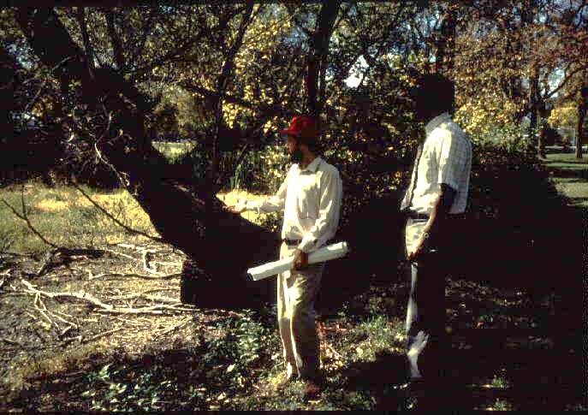
7-36
1. Pre-construction Inspection
Locate floodplain boundaries
Setbacks
No encroach-
ment in the
floodway

Slide 8
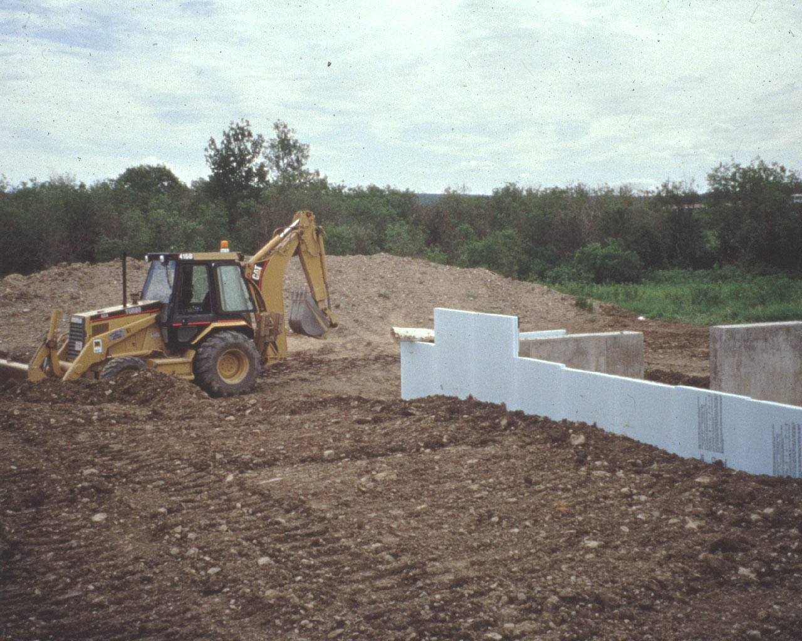
7-36
2. Elevation Inspection
Timing
Slab: forms are placed
Elevated: foundation completed
Floodproofed: when done

Slide 9
7-36
2. Elevation Inspection
Check for:
Lowest floor elevation
Fill compaction
Locations on site
Foundation openings

Slide 10
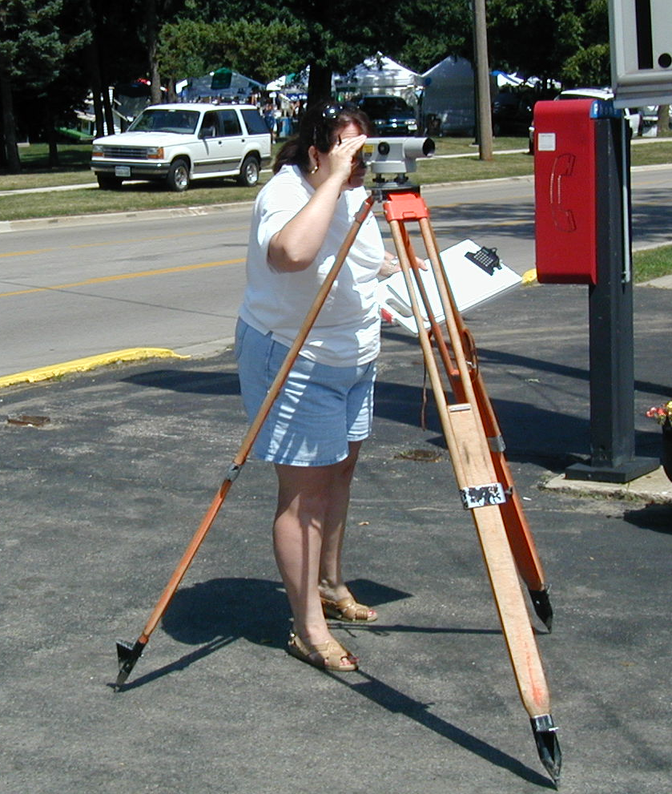
7-38
3. Final Inspection
Check for:
Floor elevation
Enclosures
Equipment/utilities
Floodway
Anchoring
EC complete?
If all OK → Certificate of Occupancy

Slide 11
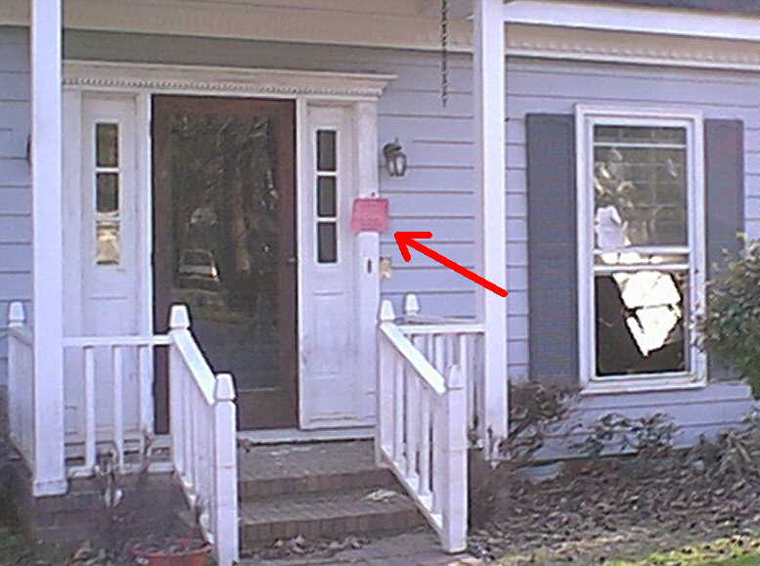
7-41
Enforcement
Withhold certificate of occupancy
Legal action with attorney
Record violation in deed records
Section 1316
  No more flood insurance
  No claim payment
  No mortgage/home loan
  No disaster assistance

Slide 12
7-56
Records at the time of the permit
Permit application and site plan
Other permits issued/not needed
Substantial improvement tracking
No rise certificate (in floodway)
1 foot rise certificate (no floodway mapped)

Slide 13
7-56
Records after the permit is issued
Second inspection elevation record
Final construction Elevation Certificate
Final construction Floodproofing Certificate
Certificate of Occupancy

Slide 14
7-36
2. Elevation Inspection
Timing
Slab: forms are placed
Elevated: foundation completed
Floodproofed: when done
Questions?

Slide 15
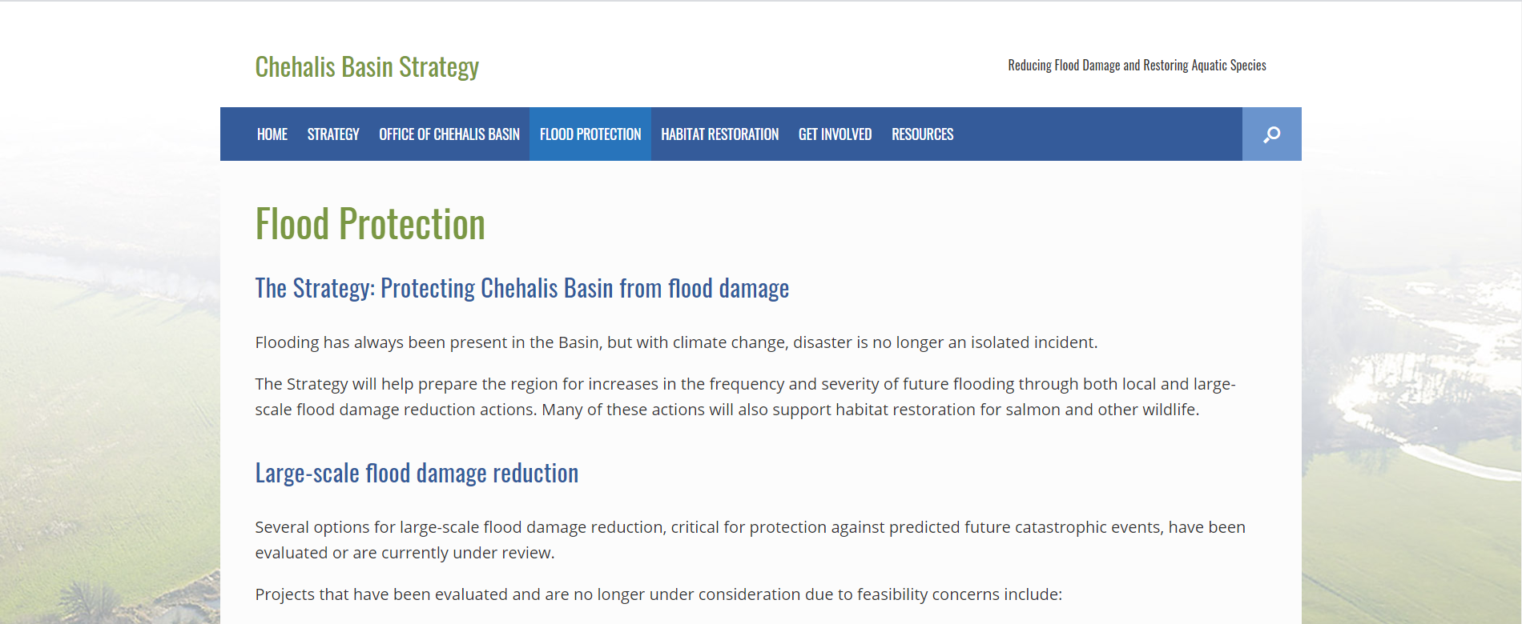
Basics of Floodplain Regulations
Adjourn
Register for November 2 workshop
“Regulating After a Disaster”
And get references and recording at
https://chehalisbasinstrategy.com

